Slide 1
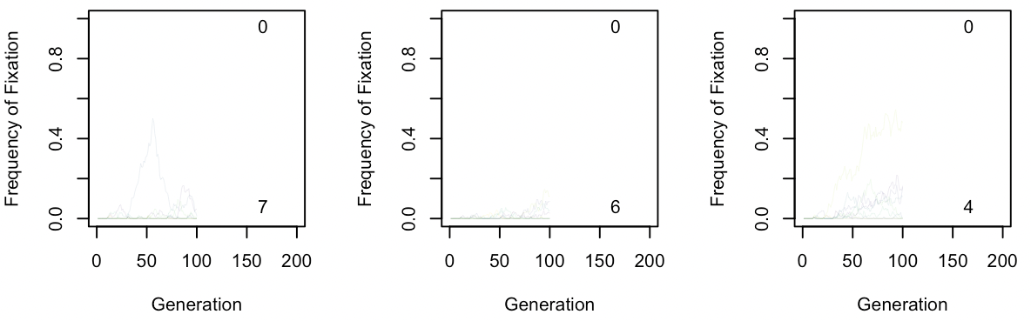
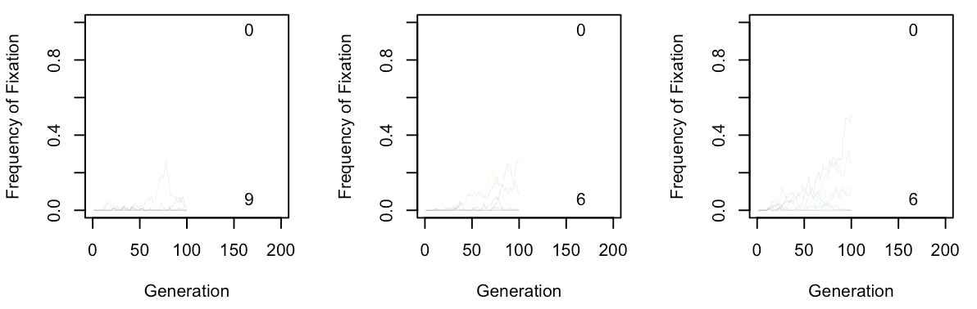
Trial runs using Y chromosome
w/o aneuploidy : pbar=10
10⁻⁸
10⁻¹⁰
10⁻¹²
parameters
Gens= 100
Iter= 10
Pop= 500
Sdr= 5
Sal= 95
Site.ach= 99
s.ant= 0.5
h.ant=0.5
w/ aneuploidy=0.5, pbar=81
10⁻⁸
10⁻¹⁰
10⁻¹²
Note: Original code, Achiasmy should be highest when mutation rate is 10⁻¹²
Notes:
Trial run 1

Slide 2
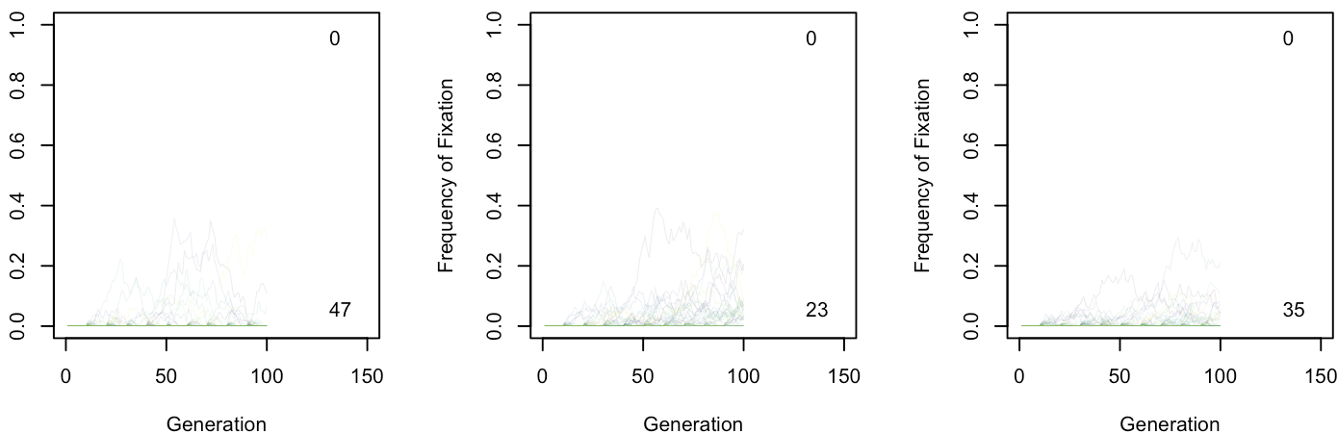
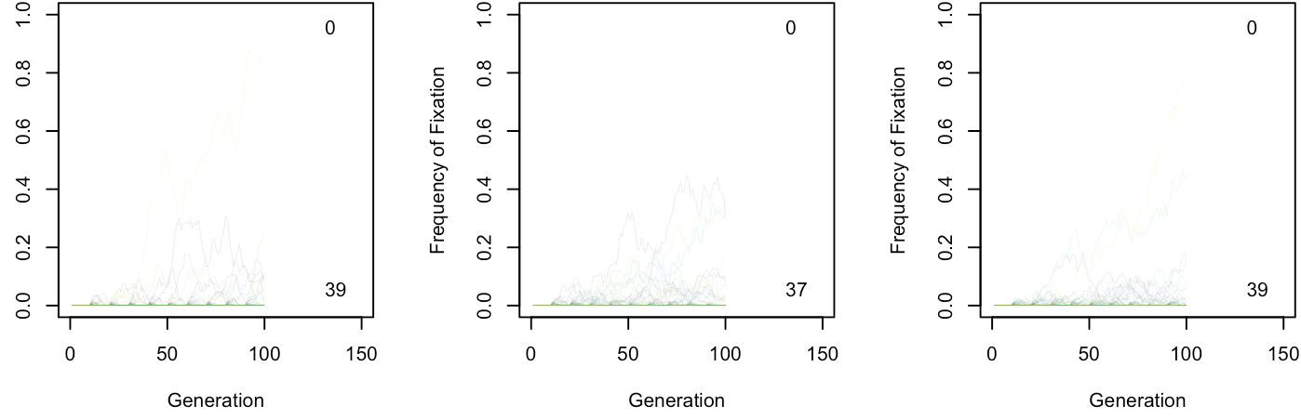
w/o aneuploidy : pbar=10
10⁻⁸
10⁻¹⁰
10⁻¹²
parameters
Gens= 100
Iter= 50
Pop= 500
Sdr= 5
Sal= 95
Site.ach= 99
s.ant= 0.5
h.ant=0.5
w/ aneuploidy=0.5, pbar=81
10⁻⁸
10⁻¹⁰
10⁻¹²
Note: Only difference between slide 1 and 2 is iteration number; all other trials use 50 as iteration number
Notes:
Trial run 2

Slide 3
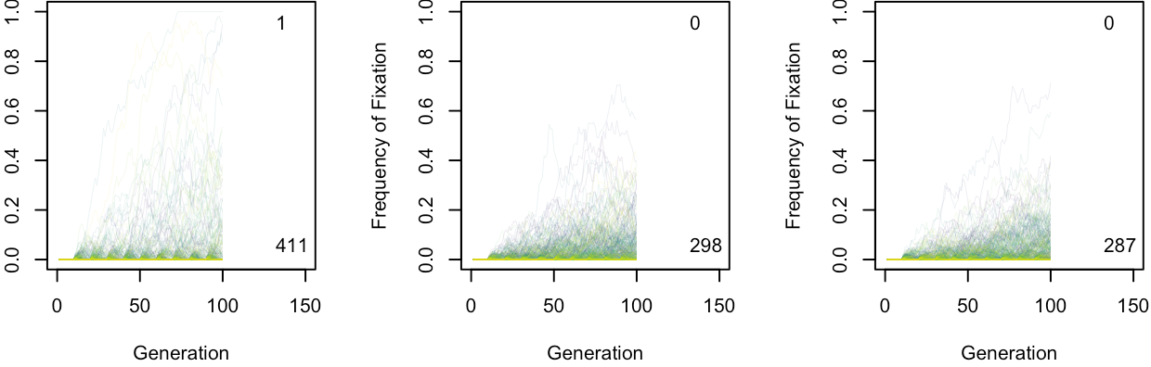
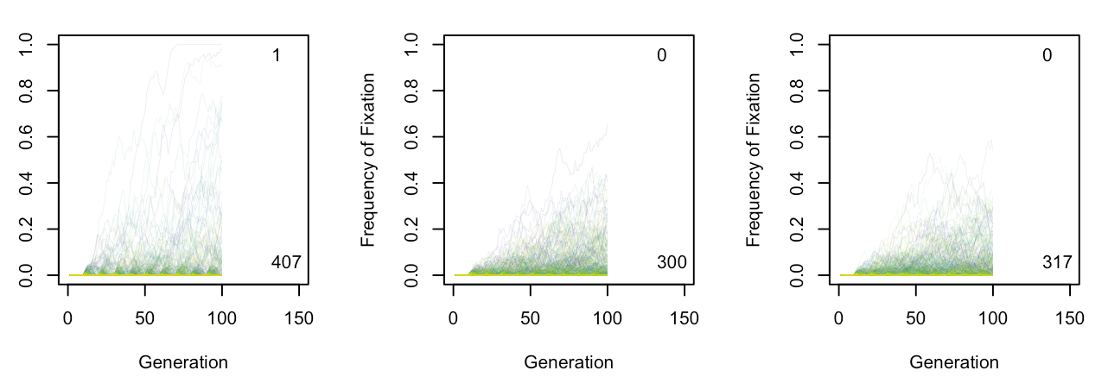
w/o aneuploidy : pbar=81
10⁻⁸
10⁻¹⁰
10⁻¹²
parameters
Gens= 100
Iter= 500
Pop= 500
Sdr= 5
Sal= 95
Site.ach= 99
s.ant= 0.5
h.ant=0.5
w/ aneuploidy=0.5, pbar=81
10⁻⁸
10⁻¹⁰
10⁻¹²
Note: difference is presence on aneuploidy, pbar for both is 81 (old model +/- aneuploidy)
Notes:
Trial run 4

Slide 4
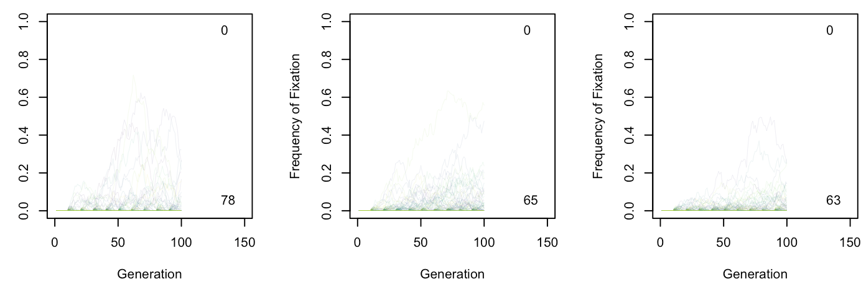
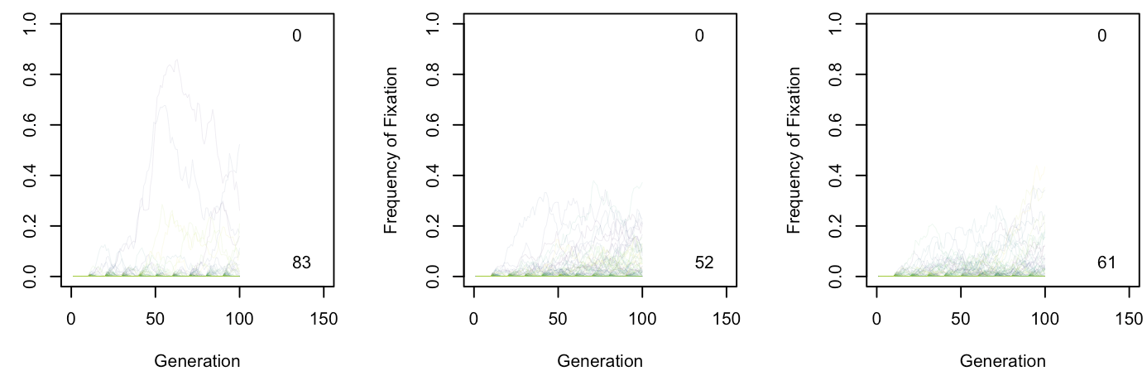
w/o aneuploidy : pbar=10
10⁻⁸
10⁻¹⁰
10⁻¹²
parameters
Gens= 100
Iter= 100
Pop= 500
Sdr= 5
Sal= 95
Site.ach= 99
s.ant= 0.5
h.ant=0.5
w/ aneuploidy=0.5, pbar=81
10⁻⁸
10⁻¹⁰
10⁻¹²
Note: iteration at 100
Notes:
Trial run 5

Slide 5
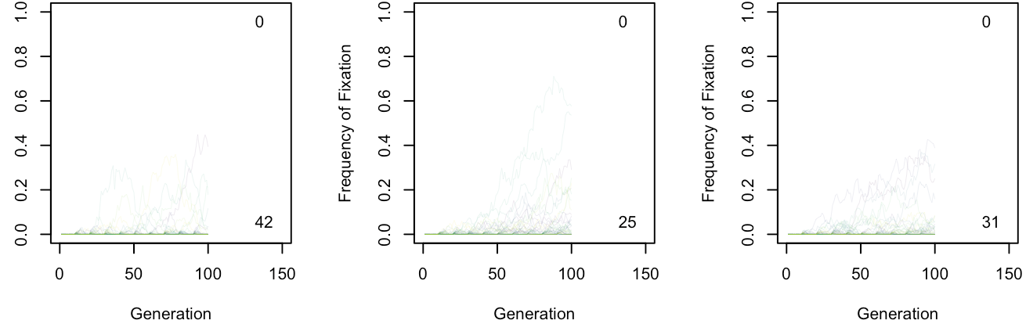
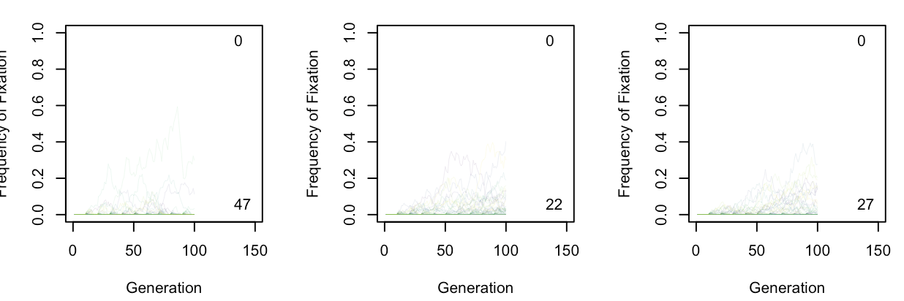
w/o aneuploidy : pbar=10
10⁻⁸
10⁻¹⁰
10⁻¹²
parameters
Gens= 100
Iter= 50
Pop= 500
Sdr= 5
Sal= 95
Site.ach= 99
s.ant= 0.5
h.ant=0.5
w/ aneuploidy=0.5, pbar=10
10⁻⁸
10⁻¹⁰
10⁻¹²
Note: difference is presence on aneuploidy, pbar for both is 10 (young model +/- aneuploidy)
Notes:
Trial run 3

Slide 6
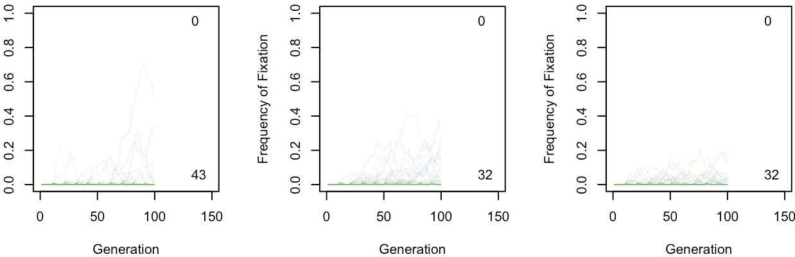
w/o aneuploidy : pbar=81
10⁻⁸
10⁻¹⁰
10⁻¹²
parameters
Gens= 100
Iter= 50
Pop= 500
Sdr= 5
Sal= 95
Site.ach= 99
s.ant= 0.5
h.ant=0.5
w/ aneuploidy=0.5, pbar=81
10⁻⁸
10⁻¹⁰
10⁻¹²
Note: difference is presence on aneuploidy, pbar for both is 81 (old model +/- aneuploidy)
Notes:
Trial run 4

